Slide 1
Cell Imaging 2026 Solution Description
John Ahn, Demetrius Schank, Jonathan Kim

Slide 2
Introduction
Current methods for cell imaging require expensive technology. Furthermore, the most accurate way to define cell boundaries without the expensive technology is to do it manually, segmenting the cells by hand and counting them. As one can assume , this is very timely and inefficient. Thus, this project was tasked with finding an image analysis method to detect cell boundaries and count cells with accuracy and precision using MATLAB. Existing technologies (both MATLAB and non-MATLAB) exist for edge detection, but the goal of this project is to develop these technologies to accomplished what is described above in a costly manner.
In addition to our basic premise, we are tasked with identifying properties of our choosing about the cells we analyze. The 2025 Senior group analyzed a small dataset frames from a live cell imaging demo of 3T3 cells to determine the velocity of cells in capillaries. Our main task at hand is determining what we want to device from cell image analysis besides just cell boundaries and cell count. Due to the various types of imaging techniques and the metadata it can detect (fluorescence microcopy, polarized light microscopy, confocal dual spinning disk microscopy, etc.), deciding the course of action has required extensive research.
Currently, we are looking into the plausibility of detecting sickle cell disease from cell images.

Slide 3
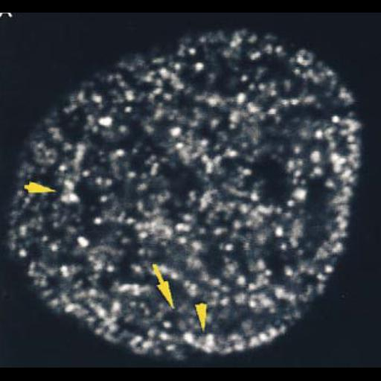
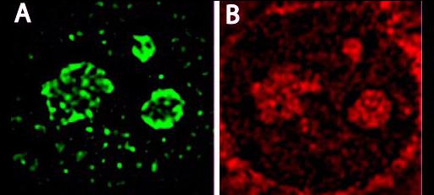
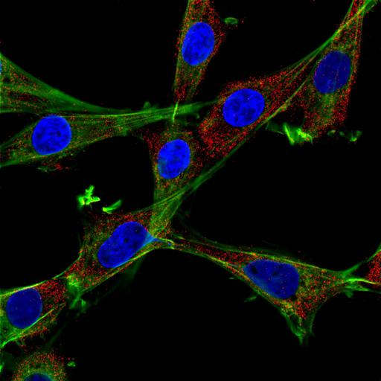
Imaging Examples
Confocal Microscopy on 3t3 cells
Fluorescence Microscopy + Phase Contrast Microscopy on 3t3 cells
Different Types of Microscopy gives different visual data and metadata that can be used to determine properties of cells!
Single-spot confocal microscopy on NIH3t3 cells

Slide 4
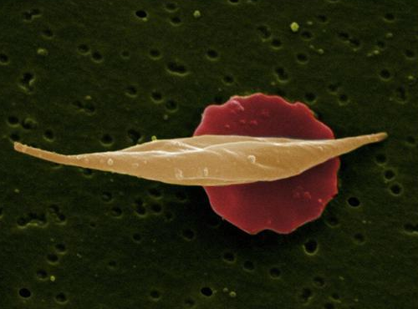
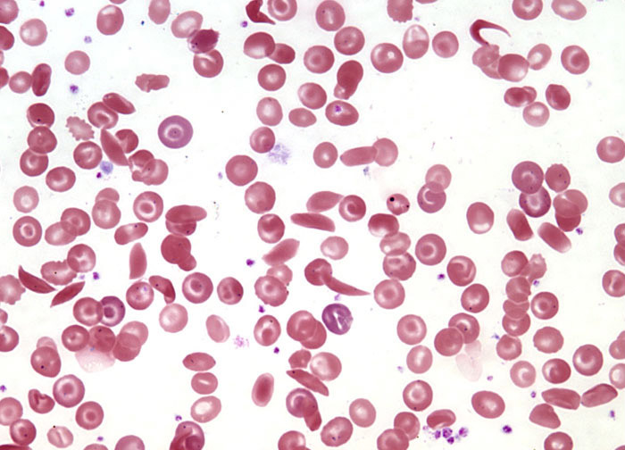
Sickle Cell Disease
Fluorescence Microscopy
Sickle Cell Disease (SCD) is a genetic disorder where red blood cells become rigid and sickle-shaped due to abnormal hemoglobin (HbS), leading to blockages in blood vessels and reduced oxygen delivery.
Light microscopy helps visualize the sickled cells, while fluorescence microscopy highlights hemoglobin distribution and oxidative stress
Light Microscopy

Slide 5
Constraints and criteria
Constraints:
Be user friendly to graduate students and researchers
Graduate Student – Jiahaw “Jay” Fu
Be affordable to graduates and researchers
Detect cell shapes as accurately as possible
Use one type of microscopy (consistency).
Detect properties of a cell
Currently looking into whether a cell is a sickle cell or healthy cell.
Criteria:
Must be implemented using MATLAB
Must use an already existing dataset (ie. We are not imaging cells ourselves)
Must not make a physical device
Must detect cell boundaries

Slide 6
FlowChart
Start
Input Image
Preprocessing
(denoising, image enhancing, possible grayscale conversion)
Processing
(Cell/shape threshold detection, cell roundness calculation)
Cell is likely round
Yes
Classify Healthy
No
Classify Healthy
End

Slide 7
Processing Example

Slide 8
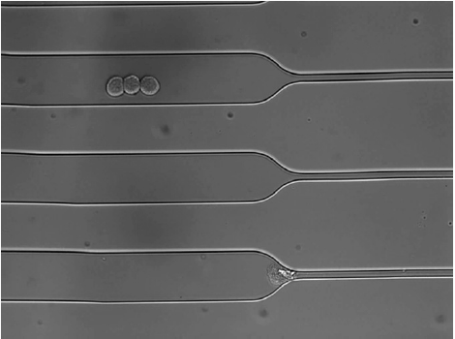
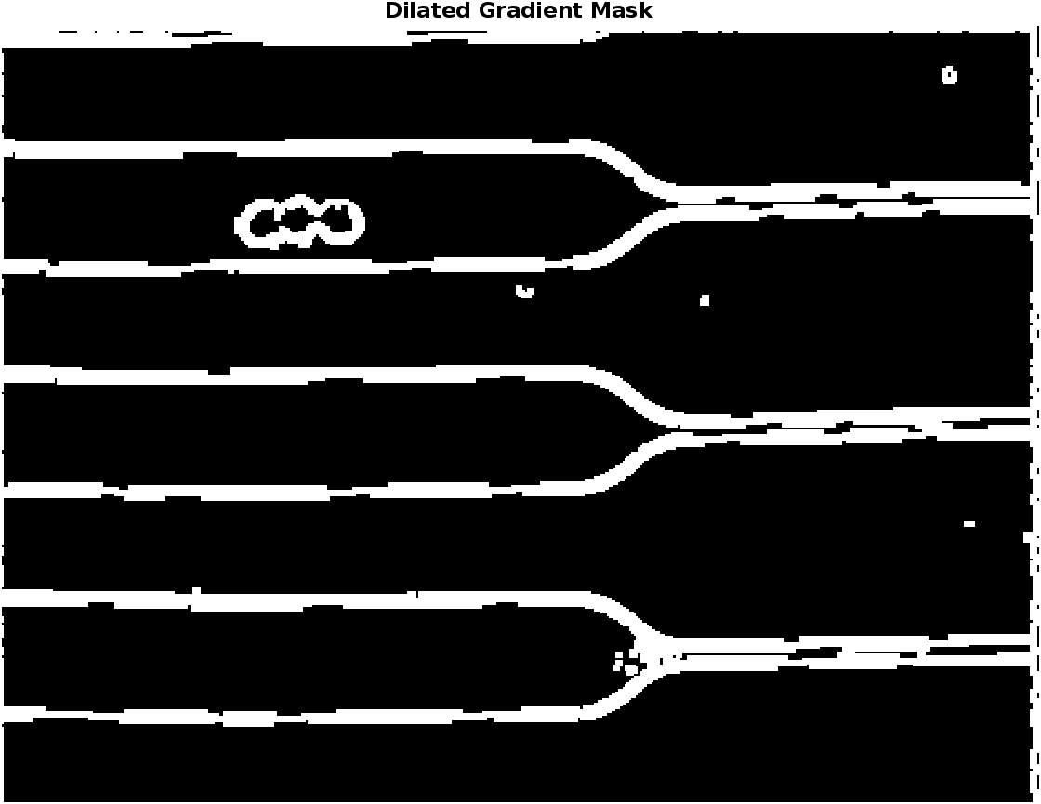
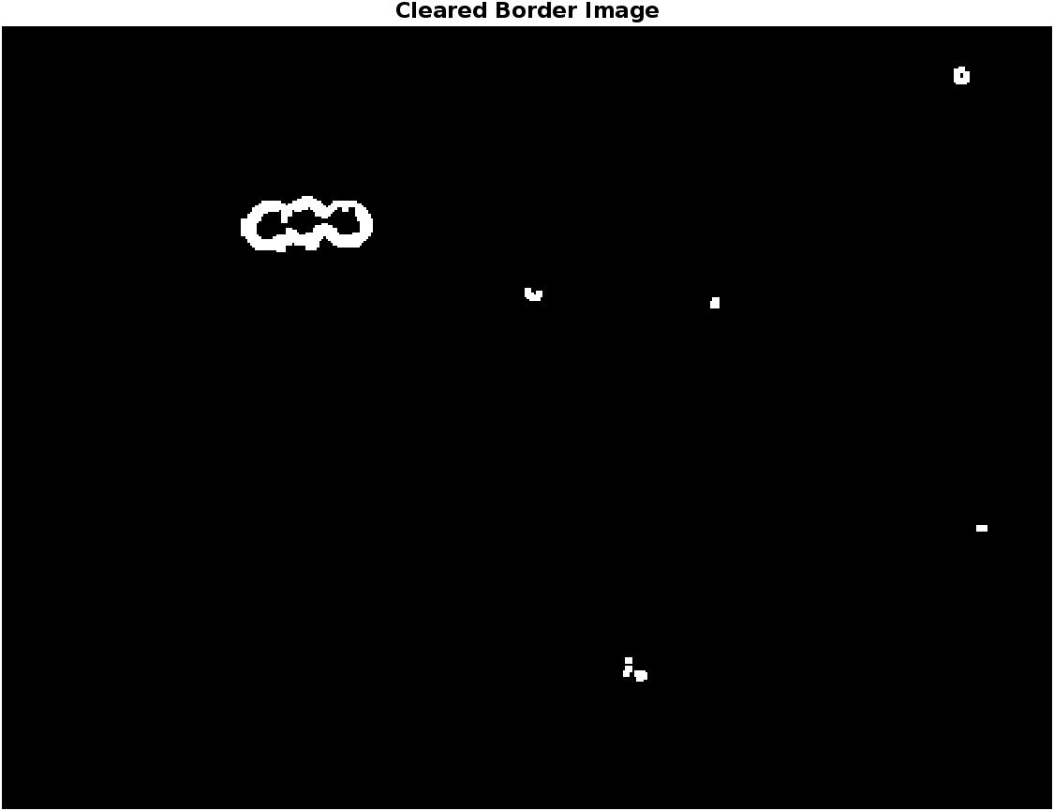
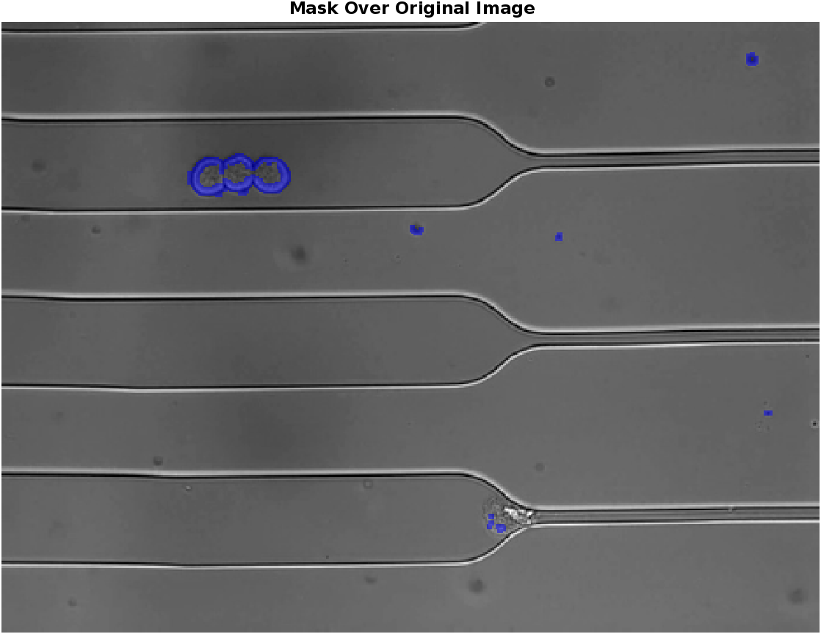
Original Image
Find significant change in contrast in image and fill gaps
Remove objects connected to border
Highlight and overlay

Slide 9
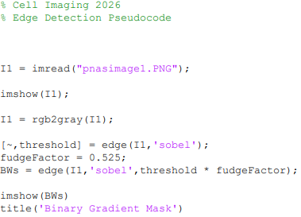
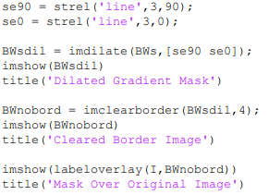
MATLAB CODE

Slide 10
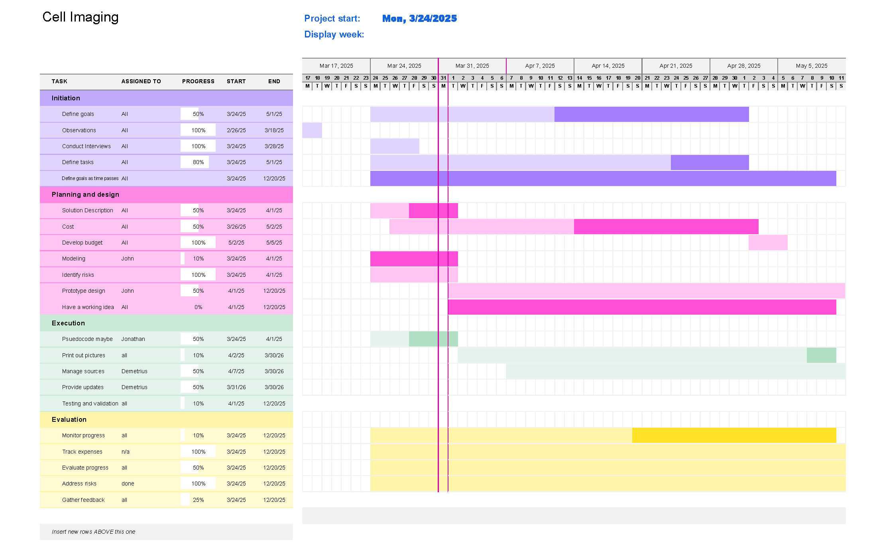
Gantt chart

Slide 11
Thank you
Questions?

